Slide 1
BTech Final Project Presentation A.Y. 2022-2023 Project Title: Image Tampering Detection
Presented by : Vardhaman Munot B033, Aniket Dubey B064, Jash Shah B072, Prince Tibadia B079
Under the guidance of : Prof. Mahesh Maurya

Slide 2
Roadmap
Introduction
Problem statement
Literature Review
Proposed System
Design diagram
Implementation done till date
Plan for next semester
References

Slide 3
Introduction
People tend to believe what they can see, and this affects their judgment, which leads to a series of unwanted responses. Because fabrications have become widespread, the urgency to detect forgeries has significantly increased.
Image forgery is done mainly for malicious reasons.
It serves to distort information, spread immorality and fake news, obtain money fraudulently from an unsuspecting audience, ruin the reputation of a popular celebrity or any other public figure, and spread adverse political influence among the users of a digital platform.
For above reasons, it is vital to develop methods of detecting whether an image is forged and to locate the region of manipulation.

Slide 4
Problem Statement
To identify a tampered image is a challenging task. Reliability of an image being shared which is tampered is lost. This project aims to develop an application that stores genuine images, protecting users against fake images and the impact that they may have on unsuspecting users.

Slide 5
Literature Review

Slide 6
Mukesh Patel School of Technology Management & Engineering Mumbai Maharashtra
Details of Paper Reviewed
Title of Paper-1 | Detecting fake images by identifying potential texture difference
Summary | Advantages | Limitations | Inference drawn (In points) | Data Collection methods | Evaluation and Performance parameters
GAN classification network efficiently learns the exposed difference and realizes the real and fake detection of face images. | High detection accuracy in both full image training and face image training. The enlarged texture features help the network to quickly and accurately capture the differences | Network model training requires large-scale data to achieve good results. For the unknown tampering method, it is still necessary to train a new authentication network. | The subtle texture differences that exist between the real and fake face image and manifest them through the image saliency method. | Faceforensics++ dataset is used as the verification dataset of the proposed method. Deepfake, and FaceSwap were used for manipulation to obtain Deepfake images. | Randomly took 14,000 images from 140 videos as the test set, including 2800 real images and 11,200 fake images and conducted guided filter on them and tested the accuracy in the model.

Slide 7
Mukesh Patel School of Technology Management & Engineering Mumbai Maharashtra
Details of Paper Reviewed
Title of Paper-2 | Fake Image Detection in Twitter using Flood Fill Algorithm and Deep Neural Networks
Summary | Advantages | Limitations | Inference drawn (In points) | Data Collection methods | Evaluation and Performance parameters
The authors utilize the flood fill algorithm to highlight the forged object in the image and a Deep Learning based solution is proposed to detect whether the image is fake or genuine. | No model exists to detect diffused images. | Takes a lot of time Takes a lot of space | The literature compared the proposed methodology with Naive-Bayes, SVM and Random Forest which show that using Deep Neural Networks is significantly better than existing models. | Dataset is collected from publicly available image verification corpus consisting of over 800 fictitious and genuine images. | The framework was evaluated on the basis of robustness, accuracy, precision, recall and F1 score. The accuracy achieved was 96%.

Slide 8
Mukesh Patel School of Technology Management & Engineering Mumbai Maharashtra
Details of Paper Reviewed
Title of Paper-3 | Intelligent Morphed Image Identification using Error Level Analysis and Deep learning
Summary | Advantages | Limitations | Inference drawn (In points) | Data Collection methods | Evaluation and Performance parameters
Convolutional Neural Networks are a type of neural network that are used effectively in image recognition classification and applications. An application for it is described in this paper. | The main advantage of CNN compared to its predecessors is that it automatically detects the important features without any human supervision ELA works by re-saving the image at 95% compression, and evaluating the difference with the original. Modified areas are easily seen due their characteristic aspects in the ELA representation. | For each false image, we have a corresponding mask. We use this mask to sample false images along the edges of the sewing area to ensure that the false and non-false parts of the image contribute at least 25%. | The results obtained from the proposed method have obtained an accuracy of 91.33% that is reflected in form of accuracy curve and the loss curve. The best accuracy is obtained on the 9th epoch. | CASIA 2.0 which contains 7491 original images and 5123 tampered images. The size of the dataset is changed to 224x224 pixels. | The proposed model achieved an accuracy of 91.33%. The presented model predicted 536 out of 574 original images and 321 out of 369 tampered images accurately.

Slide 9
Mukesh Patel School of Technology Management & Engineering Mumbai Maharashtra
Details of Paper Reviewed
Title of Paper-4 | Image forgery detection using ELA and Deep Learning
Summary | Advantages | Limitations | Inference drawn (In points) | Data Collection methods | Evaluation and Performance parameters
Divide the dataset from into 2 categories, normalize the image, perform analysis on the level of compression error image, from the compression result use VGG 16 for CNN in recognizing the image according to the ELA. | VGG16 has gained recognition for precision, they used VGG16 as a pre-training model for original image and forgery images recognition. | Image quality deteriorates after using ELA | Dataset divided into tampered images and original images, VGG 16 is used for training because VGG is perfect for training with minimal datasets. | CASIA 2.0 which contains 7491 original images and 5123 tampered images. The size of the dataset is changed to 224x224 pixels. | Training accuracy of the model is achieved up to 92.2% and for validation 88.46% using 100 epoch.

Slide 10
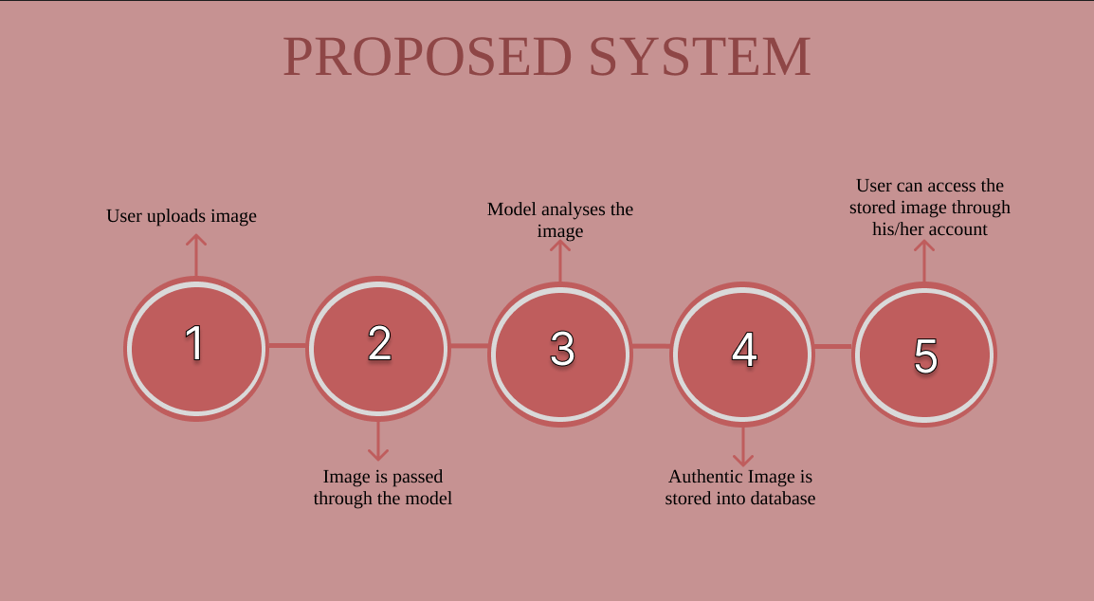
Proposed System

Slide 11
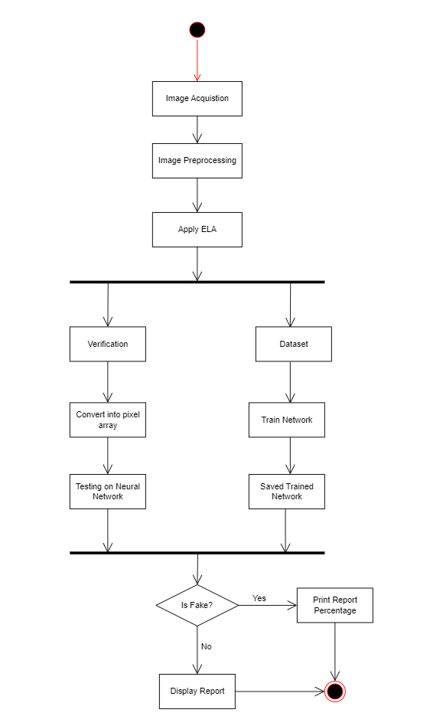
Design Diagram for Model

Slide 12
Implementation done till date
Referred to various research papers pertaining to our domain.
Created the model which will verify if the image is tampered or authentic using ELA & CNN methodology.
The model was trained with CASIA 2.0 dataset with 80:20 split ratio.
The model has been tested with custom images and has achieved accuracy of 94% and it converges at 40 epochs.
Compared frameworks to be used along with the model on the backend.

Slide 13
Plan for the next semester
Create a front end for the WebApp.
Compare and evaluate different encryption algorithms.
Integrate the encryption algorithm with the WebApp.
Create a SQLite database that stores the authentic images.
Test the WebApp for bugs.
Document all work done.

Slide 14
References
Yang, Jiachen, et al. "Detecting fake images by identifying potential texture differences." Future Generation Computer Systems 125 (2021): 127-135.
Birunda, S. Selva, et al. "Fake Image Detection in Twitter using Flood Fill Algorithm and Deep Neural Networks." 2022 12th International Conference on Cloud Computing, Data Science & Engineering (Confluence). IEEE, 2022.
Kumar, Gaayan, Sunil Kumar Chowdhary, and Abhishek Srivastava. "Intelligent Morphed Image Identification using Error Level Analysis and Deep learning." Elementary Education Online 20.5 (2021): 7181-7181.
Sudiatmika, Ida Bagus Kresna, et al. "Image forgery detection using error level analysis and deep learning." TELKOMNIKA (Telecommunication Computing Electronics and Control) 17.2 (2019): 653-659.
Tanaka, Miki, and Hitoshi Kiya. "Fake-image detection with Robust Hashing." 2021 IEEE 3rd Global Conference on Life Sciences and Technologies (LifeTech). IEEE, 2021.

Slide 15
Zheng, Lilei, Ying Zhang, and Vrizlynn LL Thing. "A survey on image tampering and its detection in real-world photos." Journal of Visual Communication and Image Representation 58 (2019): 380-399.
He, Peisong, Haoliang Li, and Hongxia Wang. "Detection of fake images via the ensemble of deep representations from multi-color spaces." 2019 IEEE international conference on image processing (ICIP). IEEE, 2019.
Gunawan, Agus, Holy Lovenia, and A. Pramudita. "Deteksi Pemalsuan Gambar dengan ELA dan Deep Learning." (2018).
Zhang, Kejun, et al. "No one can escape: A general approach to detect tampered and generated image." IEEE Access 7 (2019): 129494-129503.
Alzamil, Lubna. "Image Forgery Detection with Machine Learning." (2020).
Passos, Leandro A., et al. "A Review of Deep Learning-based Approaches for Deepfake Content Detection." arXiv preprint arXiv:2202.06095 (2022).

Slide 16
Thank You

